Slide 1
Megatrends: Data Across Disciplines

Slide 2

Hello!
I am Andy Mitchell
I am here because I love p-values!
You can find me at @gadfly1974

Slide 3


Slide 4
MY STORY
2015 NYS ELA and Math Exams and Growth Scores
Notes:
If I had know a different way to look at the data

Slide 5
Those teachers who are students of their own impact are the teachers who are the most influential in raising students’ achievement.
~ John Hattie
Notes:
John Hattie, Visible Learning for Teachers

Slide 6
Helpful link
v.gd/DATAG
case sensitive!

Slide 7
The Big Picture
🎁
previous learning
today
next steps
Notes:
THANK Rich Yeoman, Luke and his team at EduTech from GV and WFL BOCES. THANK Denny and Tim and their team from WNYRIC.
Teachers rarely have time and energy to see where their daily work fits into a larger learning trajectory. DATAG members have the opportunity to bring this gift to teachers by providing opportunities to explore the following questions
Where does my content or grade level fit into the larger K-12 system
How does student achievement change over time?

Slide 8
Click Heat Maps
v.gd/DATAG
case sensitive!

Slide 9
Drop 4 | Drop 3 | Drop 2 | Drop 1 | No change | Increase | Untested
Grade Level and Domain | Baseline 3 | 4 | 5 | 6 | 7 | 8
Ratios | NF | NF | NF | RP | RP | F
Algebra | OA | OA | OA | EE | EE | EE
Numbers | NBT | NBT | NBT | NS | NS | NS
Stats | MD | MD | MD | SP | SP | SP
Geom | G | G | G | G | G | G
Notes:
Heat maps are an efficient visualization of a huge amount of data

Slide 10
<50% | 50-54 | 55-59 | 60-64 | 65-69 | 70-74 | 75-79 | >80% | Untested
Grade Level and Domain | 7 | 8 | Algebra 1 | Geometry
Ratios | RP | F | F | F
Algebra | EE | EE | A | A
Numbers | NS | NS | N | N
Stats | SP | SP | S | S
Geom | G | G | G | G

Slide 11
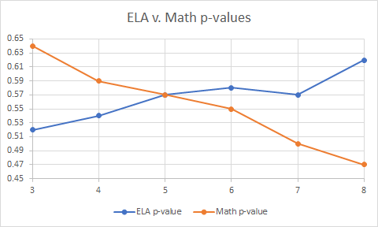
Notes:
What do you notice? What do you wonder? What might this be?

Slide 12
Notes:
2013-2017 WNYRIC data

Slide 13
Click Data Story: Math
v.gd/DATAG
case sensitive!

Slide 14

Notes:
1’ mindfulness break before interacting with our next data set

Slide 15
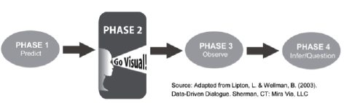
Notes:
How many unique standards are assessed on each grades 3-8 assessment, ELA and math? Share your predictions with your team members

Slide 16
Grade | ELA (assessed) | Math (assessed)
3 | 17 | 32
4 | 20 | 33
5 | 18 | 35
6 | 18 | 35
7 | 19 | 37
8 | 16 | 27
Notes:
Visualize this data. Paper is provided. Be creative with your representations.

Slide 17
Notes:
Add conversation slide
AND add in slides that correlate to the handout again

Slide 18
Click
Data Story: Megatrends
v.gd/DATAG
case sensitive!
Notes:
Note that there are three references at the end of this report. These may be valuable resources.

Slide 19
Skim this report
What works? What would you do differently for your school and district and region?

Slide 20
Read LESS IS MORE pg. 11
📈
Notes:
Remind participants to use their playlists

Slide 21
Click
Slide Deck: Less Is More
v.gd/DATAG
case sensitive!

Slide 22
View this slide deck
What works? What would you do differently for your school and district and region?

Slide 23
What works for YOU?
Notes:
How do you help your teachers, administrators, schools and districts review big picture data and trends? How does this connect to classroom instruction and student learning outcomes?
Clearer background image, make easier to read the text

Slide 24
Thanks!
Any questions?
You can find me at
@gadfly1974
andrew.mitchell@wflboces.org

Slide 26
Following slides not used for this presentation

Slide 27
Transition headline
1.
Let’s start with the first set of slides

Slide 28
Instructions for use
EDIT IN GOOGLE SLIDES
Click on the button under the presentation preview that says "Use as Google Slides Theme".
You will get a copy of this document on your Google Drive and will be able to edit, add or delete slides.
You have to be signed into your Google account.
EDIT IN POWERPOINT®
Click on the button under the presentation preview that says "Download as PowerPoint template". You will get a .pptx file that you can edit in PowerPoint.
Remember to download and install the fonts used in this presentation (you’ll find the links to the font files needed in the Presentation design slide)
More info on how to use this template at www.slidescarnival.com/help-use-presentation-template
This template is free to use under Creative Commons Attribution license. You can keep the Credits slide or mention SlidesCarnival and other resources used in a slide footer.

Slide 29
Use charts to explain your ideas
Gray
White
Black
Notes:
Multiple Measure of Data approach?

Slide 30
This is a slide title
Here you have a list of items
And some text
But remember not to overload your slides with content
Your audience will listen to you or read the content, but won’t do both.

Slide 31
You can also split your content
White
Is the color of milk and fresh snow, the color produced by the combination of all the colors of the visible spectrum.
Black
Is the color of coal, ebony, and of outer space. It is the darkest color, the result of the absence of or complete absorption of light.

Slide 32
In two or three columns
Yellow
Is the color of gold, butter and ripe lemons. In the spectrum of visible light, yellow is found between green and orange.
Blue
Is the colour of the clear sky and the deep sea. It is located between violet and green on the optical spectrum.
Red
Is the color of blood, and because of this it has historically been associated with sacrifice, danger and courage.

Slide 33
And tables to compare data
 | A | B | C
Yellow | 10 | 20 | 7
Blue | 30 | 15 | 10
Orange | 5 | 24 | 16

Slide 34
Maps
our office

Slide 35
89,526,124
Whoa! That’s a big number, aren’t you proud?

Slide 36
89,526,124$
185,244 users
100%
That’s a lot of money
And a lot of users
Total success!

Slide 37
Let’s review some concepts
Yellow
Is the color of gold, butter and ripe lemons. In the spectrum of visible light, yellow is found between green and orange.
Blue
Is the colour of the clear sky and the deep sea. It is located between violet and green on the optical spectrum.
Red
Is the color of blood, and because of this it has historically been associated with sacrifice, danger and courage.
Yellow
Is the color of gold, butter and ripe lemons. In the spectrum of visible light, yellow is found between green and orange.
Blue
Is the colour of the clear sky and the deep sea. It is located between violet and green on the optical spectrum.
Red
Is the color of blood, and because of this it has historically been associated with sacrifice, danger and courage.

Slide 38
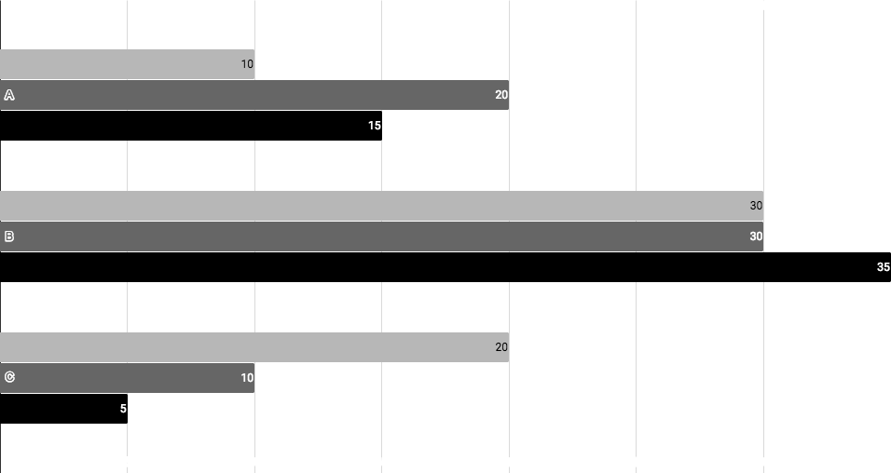
You can insert graphs from Google Sheets

Slide 39
Android project
Show and explain your web, app or software projects using these gadget templates.
Place your screenshot here

Slide 40
iPhone project
Show and explain your web, app or software projects using these gadget templates.
Place your screenshot here

Slide 41
Tablet project
Show and explain your web, app or software projects using these gadget templates.
Place your screenshot here

Slide 42
Desktop project
Show and explain your web, app or software projects using these gadget templates.
Place your screenshot here

Slide 43
Credits
Special thanks to all the people who made and released these awesome resources for free:
Presentation template by SlidesCarnival
Photographs by Unsplash

Slide 44
Presentation design
This presentation uses the following typographies:
Titles: Work sans bold
Body copy: Work sans light
You can download the fonts on this page:
https://github.com/weiweihuanghuang/Work-Sans/tree/master/fonts/desktop
You don’t need to keep this slide in your presentation. It’s only here to serve you as a design guide if you need to create new slides or download the fonts to edit the presentation in PowerPoint®

Slide 45
SlidesCarnival icons are editable shapes.
This means that you can:
Resize them without losing quality.
Change fill color and opacity.
Change line color, width and style.
Isn’t that nice? :)
Examples:

Slide 46
😉
Now you can use any emoji as an icon!
And of course it resizes without losing quality and you can change the color.
How? Follow Google instructions https://twitter.com/googledocs/status/730087240156643328
✋👆👉👍👤👦👧👨👩👪💃🏃💑❤😂😉😋😒😭👶😸🐟🍒🍔💣📌📖🔨🎃🎈🎨🏈🏰🌏🔌🔑 and many more...

